Slide 1
SOP of Finding Out the Firmware Version of ION 7300/7550

Slide 2
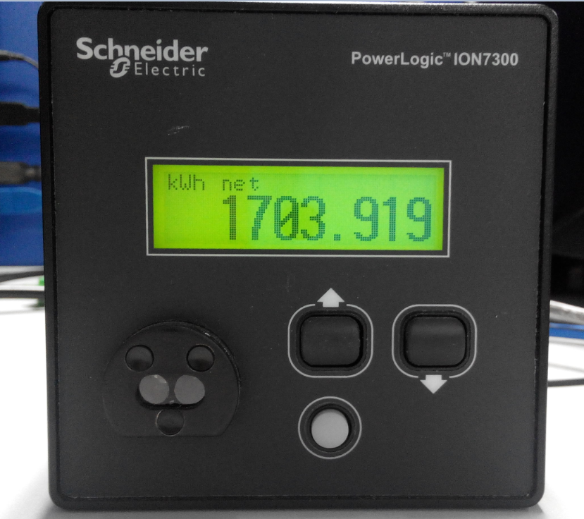
ION 7300
1. Press the button in red for 2 times.

Slide 3
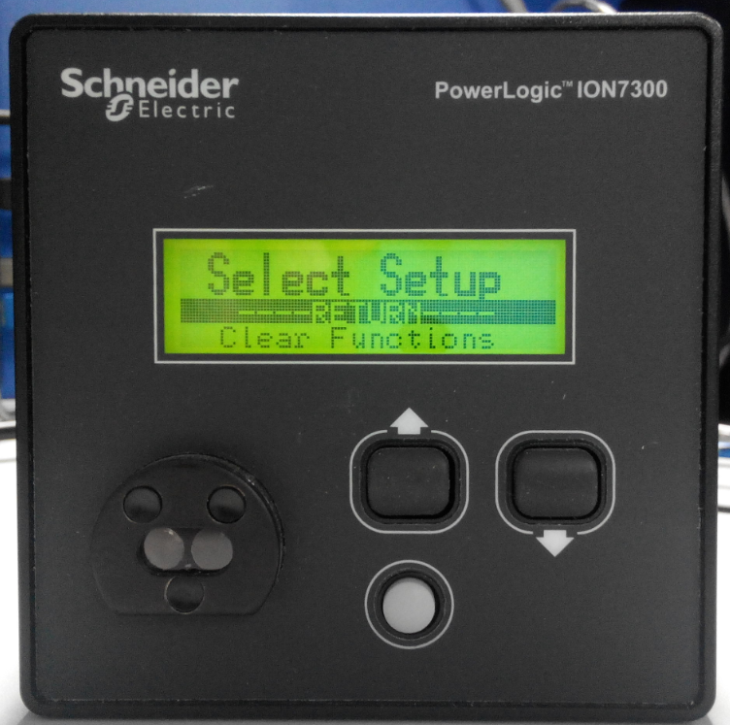
2. You will see the Select Setup menu.

Slide 4
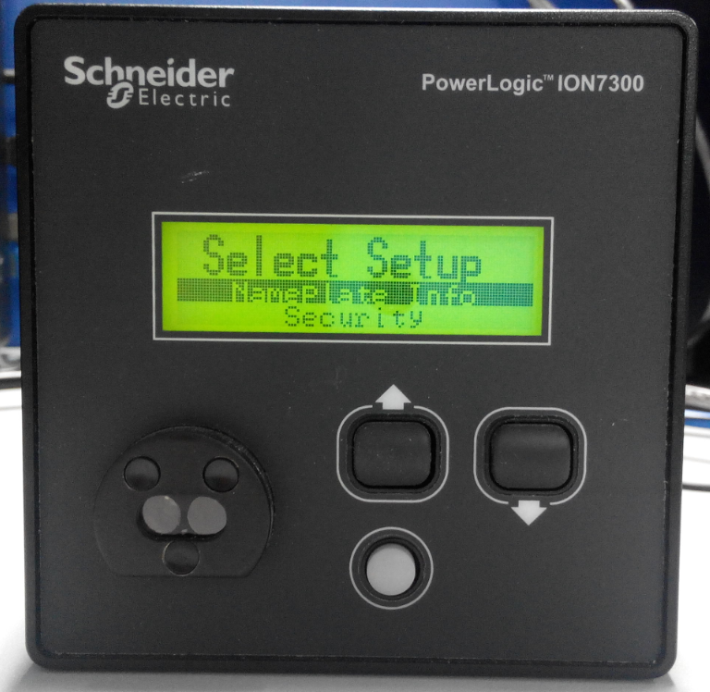
3. Press the down button to select “NamePlate Info”. Then press the white button to enter the menu.

Slide 5
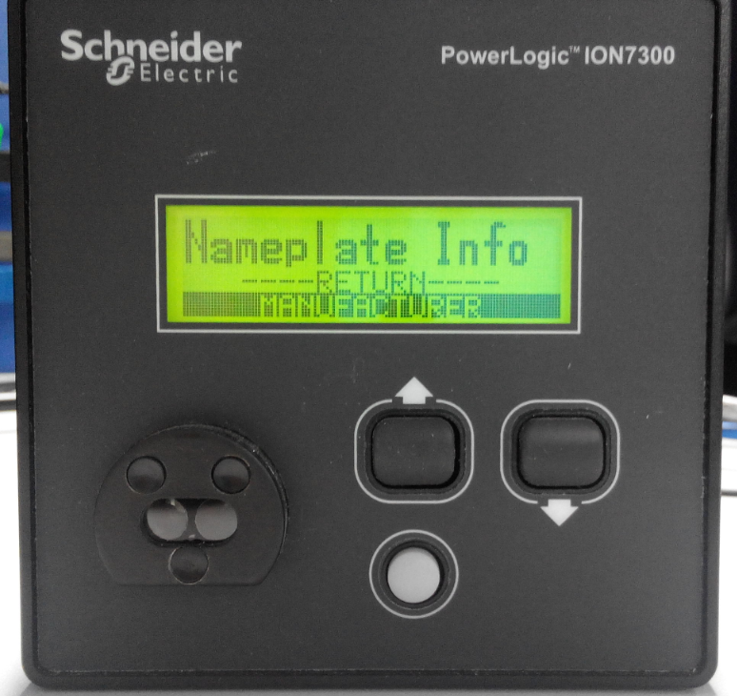
4. Select “MANUFACTURER” and press the white button.

Slide 6
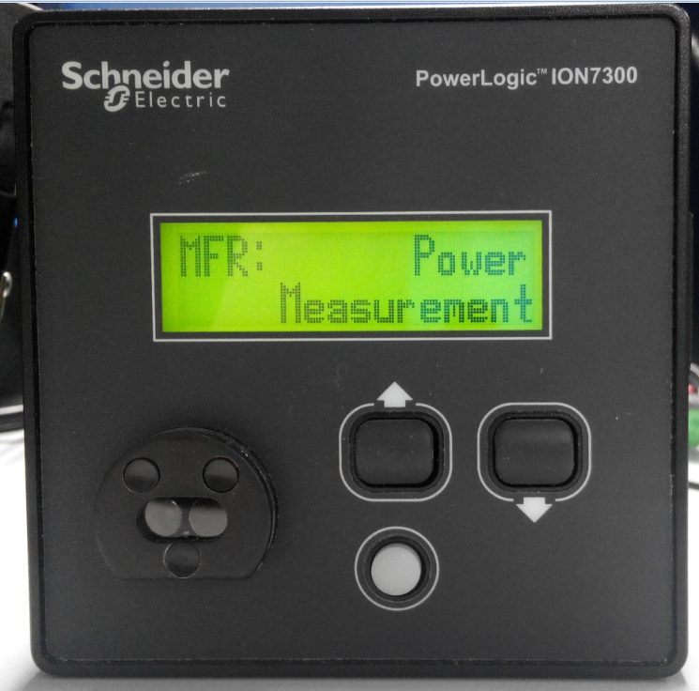
5. You will see this menu. Please press the down button.

Slide 7
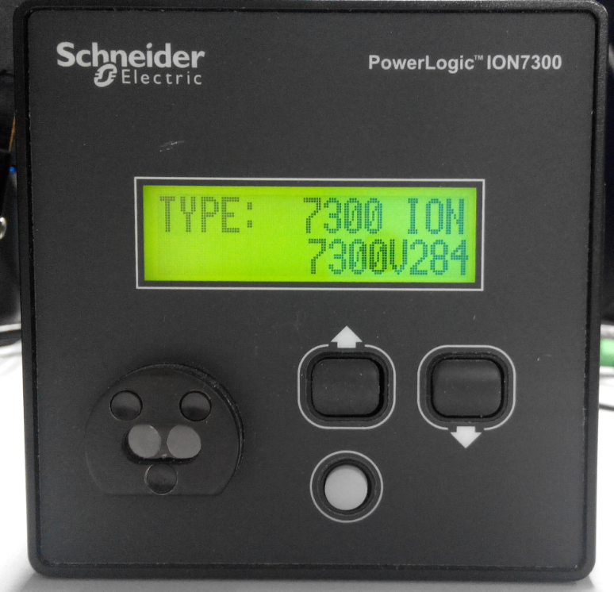
6. As you can see, the type is 7300 ION, and V284 is the firmware version.

Slide 8
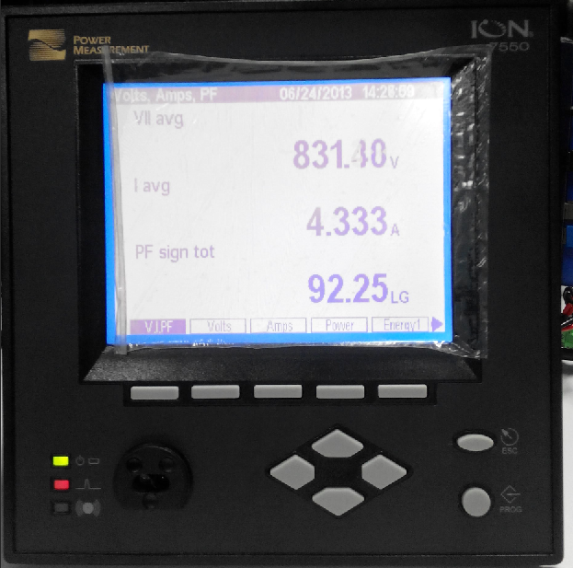
ION 7550
1. Please look at the texts in the red area, when you press the button in green, the texts will change. Please press the button in green until you see “Name Plt”.

Slide 9
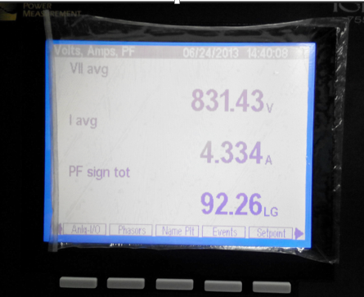
2. When you see “Name Plt”, press the button below it.

Slide 10
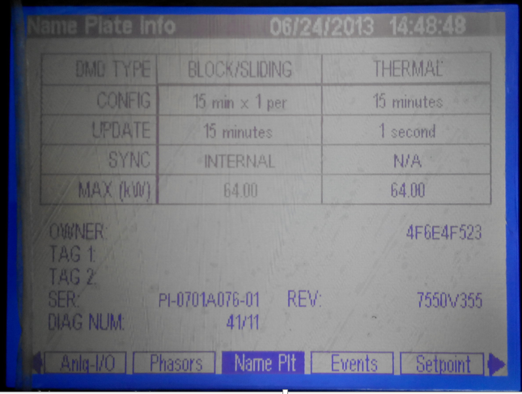
3. As shown, V355 is the firmware version.

